Slide 1
Quick Table Calculation
What Are Table Calculations?
Table calculations are calculations performed locally by Tableau.
They use only the data that makes up the view, sometimes referred to as the fieldset.
These calculations don’t affect your actual data as they are computed on the underlying data table of the view.
You can use them to transform values in the view, for instance, to create data rankings, to show running totals, or percentages of the total.
Quick table calculations allow you to quickly apply a common table calculation to your visualization using the most typical settings for that calculation type.
Quick Table Calculations are pre-computed calculations available from the menu of your field in the view, and are applied directly to the view.
These calculations are created on the returned results of the view, meaning they are dependent on the view data, not the full data table.

Slide 2
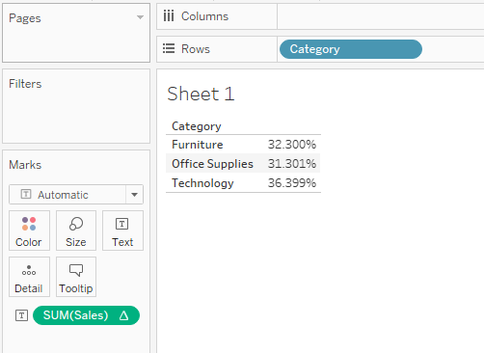
Quick Table Calculation
Calculations are 2 types in tableau.
Data base related calculations
Table related calculations : are performed based on the output of tableau.
i.e. draw some table in tableau, on that table perform some calculations.
Ex: Display % of total sales in category wise
Place category on Rows
Sales on Text in marks
Want to see % of total sales
Right click on sales in Marks card and
Choose Quick table calculation
Percentage of total

Slide 3
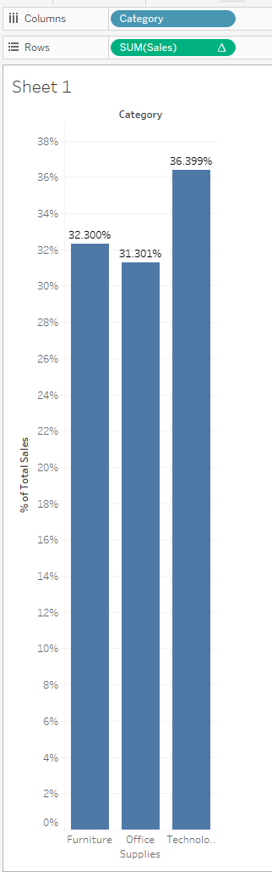
Quick Table Calculation
Ex: Display % of total sales in category wise with help of Bar graph.
Drag category on columns
Sales on rows
Now on Rows Sum(sales) right click and →
Quick table calculation → percentage of total
Click on T in tool bar

Slide 4
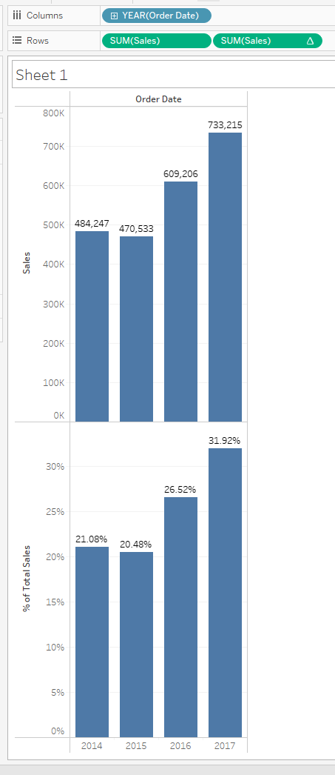
Ex3: - Display total sales based on order date as well as
% of total sales Based on order date

Slide 5
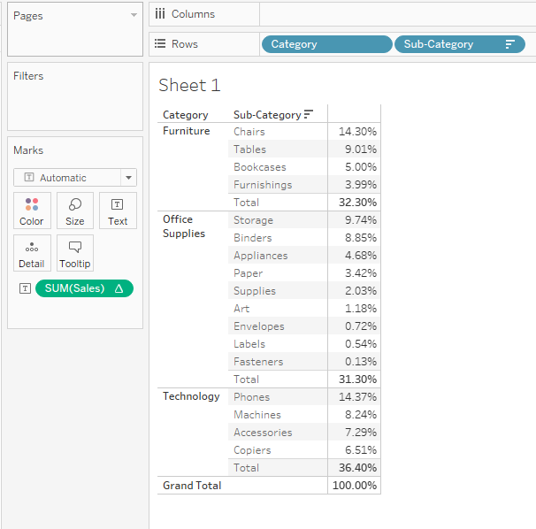
Ex 4: Calculate % sales category and
sub category wise in cross tab and
Also display Grand total as well as total for
Each category.

Slide 6
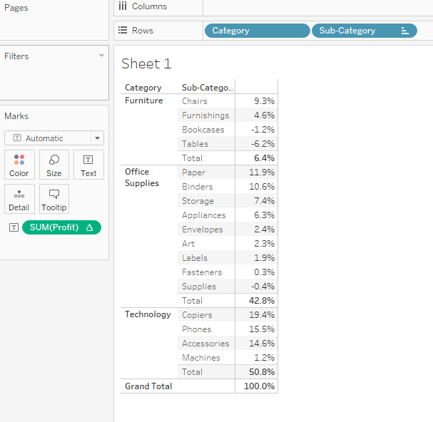
Ex 5: Instead of sales use profit

Slide 7
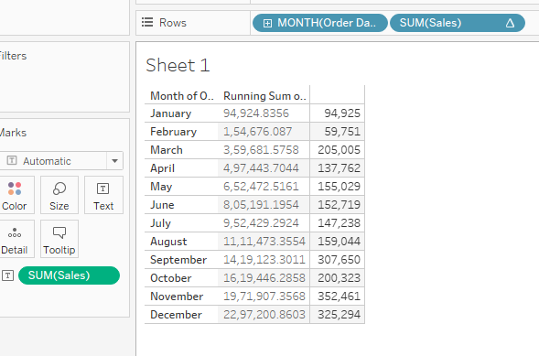
Ex 6:calculate the running total of sales based on order date
In cross table
Order date on Row
Sales on text
Get sales on Month wise by click on +
Put sales on Row and convert it into
discrete
5. In order to get cumulative addition
click on quick table calculation and choose
Running total

Slide 8
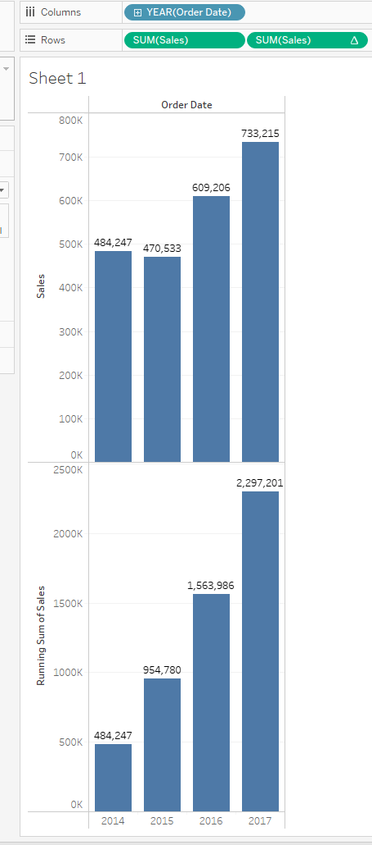
Ex 7: Ex6 with help of Bar graph

Slide 9
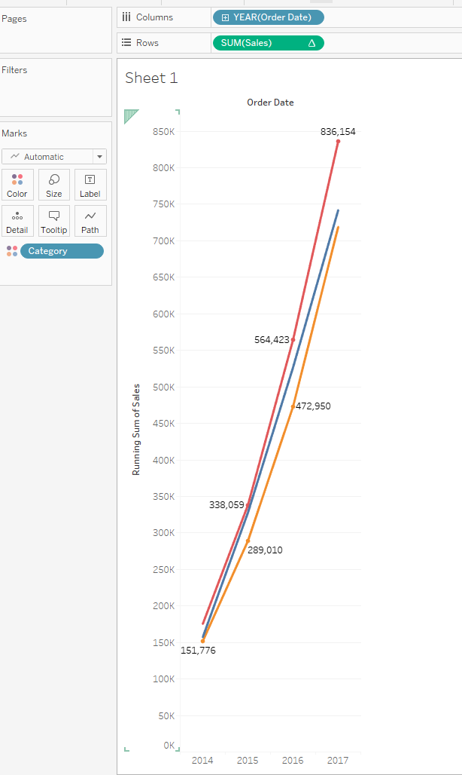
Ex 8: with help of Line chart

